Slide 1
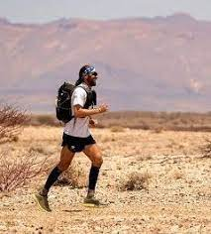
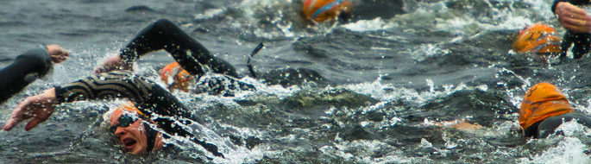
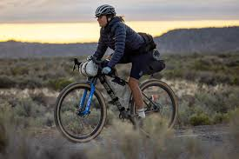
A Beginner’s Guide To Endurance

Slide 2
The Training Plan
Q - How do I prepare for a 50 km / 50 mile race?

Slide 3
Off-the-shelf training programmes:
Week 2
Mon – Rest
Tue – 35 mins easy
Wed – 15 mins easy, 10 x 2 min fast (1 min recov) 15 mins easy
Thu – 1 mile easy, 6 miles long pace
Fri – S&C
Sat – Rest
Sun – 10 miles – middle 8 long pace
Week 14
Mon – Rest
Tue- S&C
Wed – 90 mins long pace
Thu – Rest
Fri – Rest
Sat – 10 hilly miles easy
Sun – 32 miles easy
Week 1
Mon – Rest
Tue – 35 mins easy
Wed – 6-8 mile easy
Thu – S&C
Fri – 60 mins, 10 mins
fast
Sat - Rest
Sun – 8 miles, long pace
Runnerworld.com

Slide 4
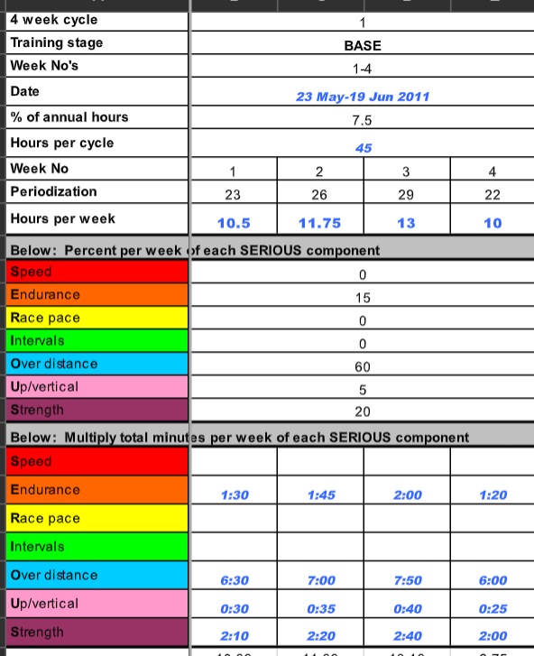
Periodization

Slide 5
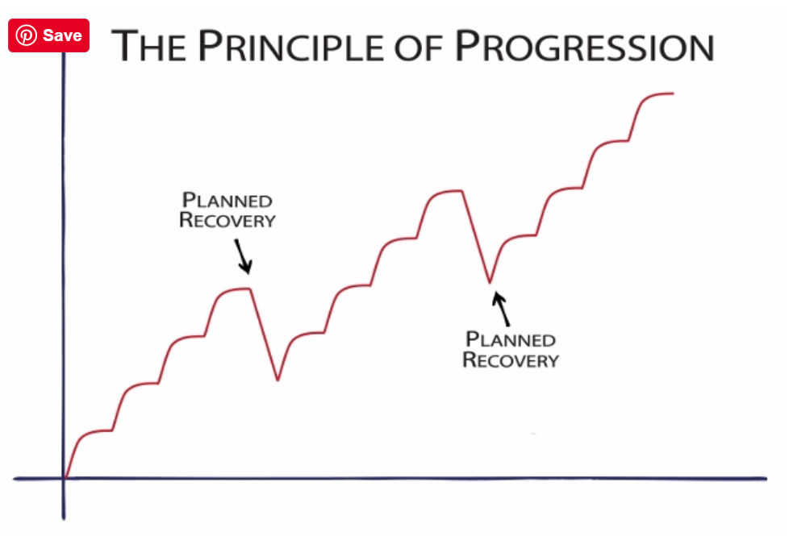
110
100
2200
90
90
2000
80
80
1800
1800
70
70
1600
1600
60
60
1400
1400
50
1200
1200
40
1000
800
Jan
Feb
Mar

Slide 6
30
40
500
120
90
1000
120
6000
100
3000
110
100
6000
4000
100
5500
100
5000
90
4500
4000
80
4000
3000
Apr
May
Jun

Slide 7
6 Month Timeline
JAN
FEB
Mileage
MAR
Big blocks
Night runs,
Dial nutrition
Small chunks (5+12+15)
Efficiency
Flexible
APR
Specificity
Vertical
MAY
Hoover
Hill reps
JUN

Slide 8
Considerations: (tips)
Tip 1
Tip 2
Tip 3
- The plan needs to fit life (not the other way around)
- Become a ‘Doorstep Hoover!’
- Run up and down hills NOT ‘in’ the hills
- A week off will do you good
- Train the gut (mile 1-100)
- Sleep, heart rate monitor, training zones…

Slide 9

Nutrition for an Ultra

Slide 10
Ultra marathons are seen as an eating and drinking competition with a bit of shuffling…
Morning of the event
During the event ‘little and often’ and remember to ‘train the gut’
Feed stations – do not overload, remember the next hill

Slide 11
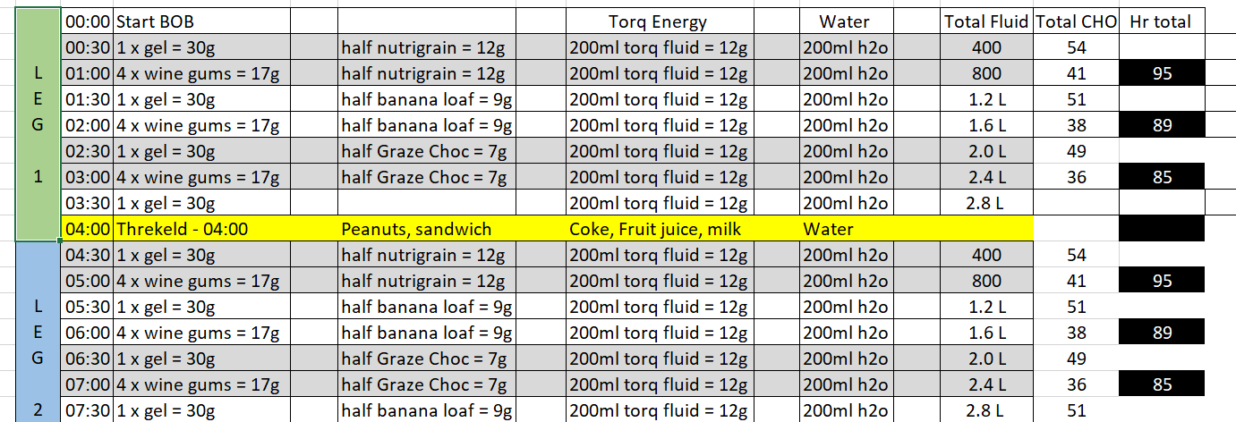
Find a feeding plan that works for you
Find what works for you based on your practiced feeding plan
Discipline – it needs to go in but there are variables

Slide 12
Considerations: (tips)
Tip 1
Tip 2
Tip 3
Train the gut
Be disciplined – stick to the plan wherever possible
I love food. Enjoy the food journey, you’ve earned it.

Slide 13
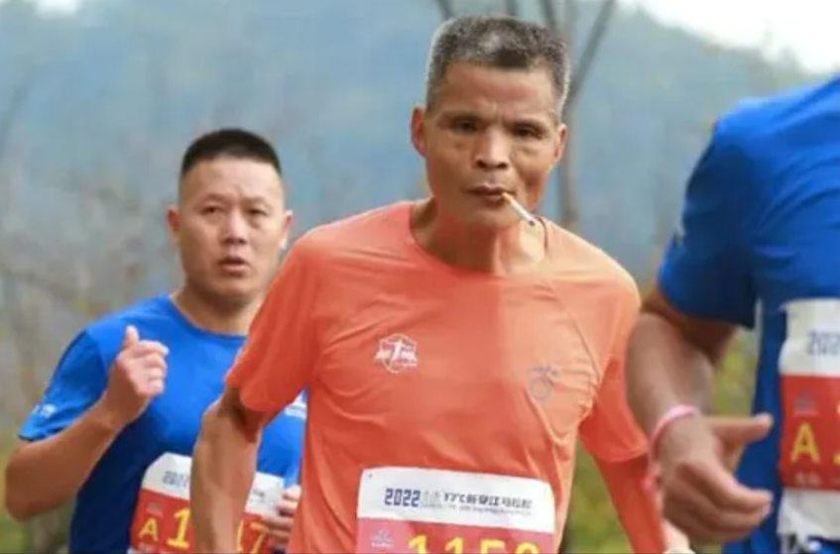
Don’t take drugs!

Slide 14
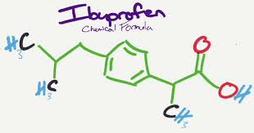
The risks of Ibruprofen during exercise

Slide 15
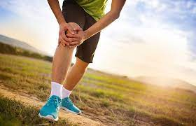
Should I train through illness or injury?
How long does it take to lose my fitness?

Slide 16

Navigation

Slide 17
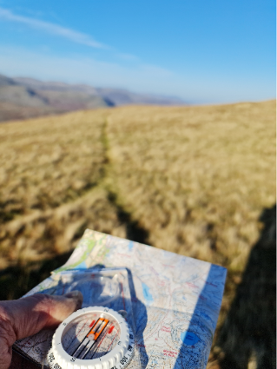
Map and Compass

Slide 18
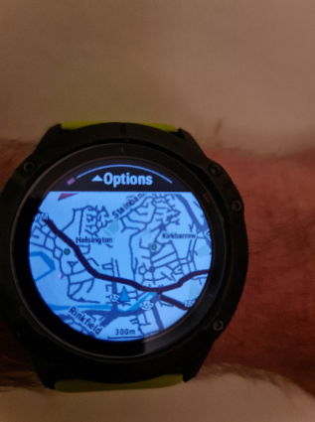
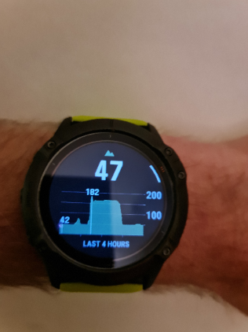
GPS Watches

Slide 19
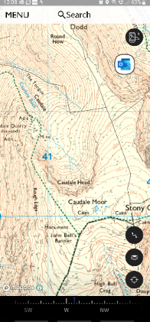
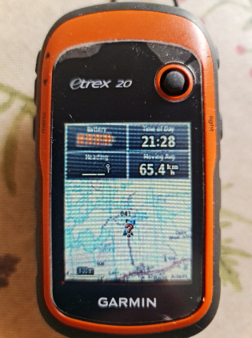
Electronic Devices

Slide 20
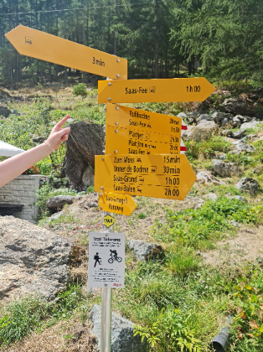
Signposts

Slide 21
Key Points
Use a map and compass – practice in good weather – make it fun
A watch to monitor the time – an altimeter is very useful
Electronic devices are great for locating your position
Look out for features to help you locate your position

Slide 22
Top Tip
Learn how to navigate with a Map and Compass
(Walking V Running)

Slide 23
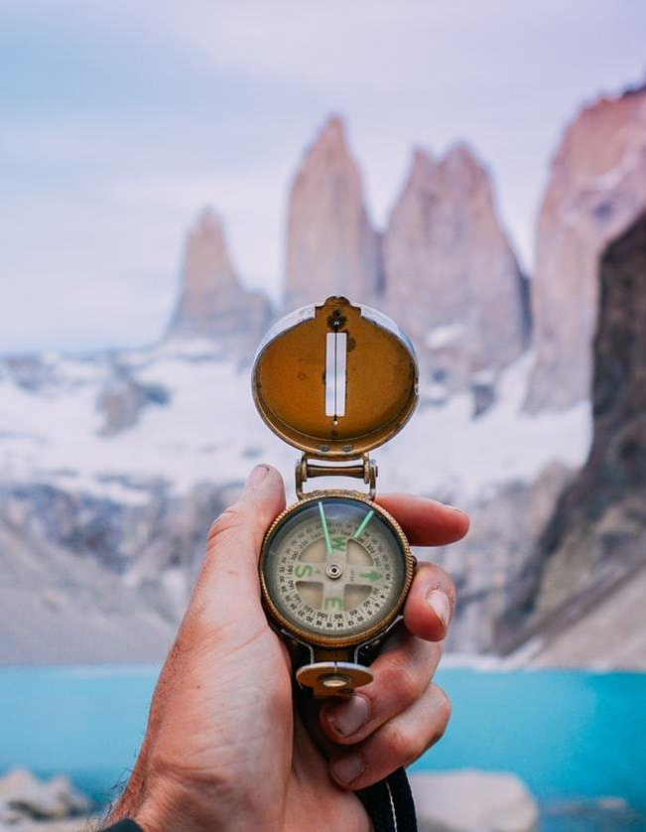
Mountain Craft
Weather Forecast
Time of Day/Night
Terrain
Equipment (waterproof Jacket & Trousers, hat & gloves, torch, poles?)
Food
Emergency / contingency plan
(extra clothing, first aid, survival kit)

Slide 24
Top Tip
Always carry a waterproof J&T – whatever the weather
Carry two torches, rather than spare batteries if running at night

Slide 25


Any questions?
www.cumbrian22.co.uk

