Slide 1

CROESO / WELCOME
FAST TRACK ADVENTURE PRO

Slide 2
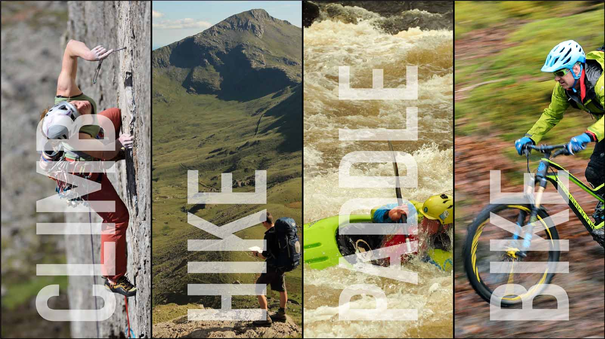

Slide 3







WORKING TOWARDS NATIONALLY RECOGNISED QUALIFICATIONS

Slide 4
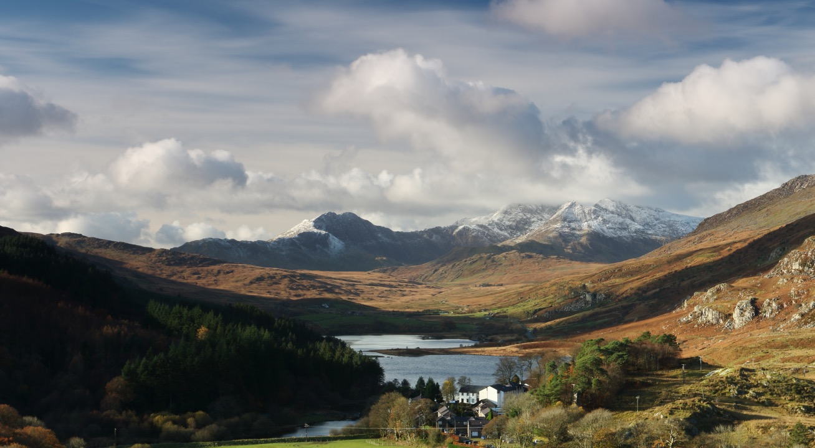
LIVE IN A GREAT PLACE

Slide 5
‘Plas y Brenin - Why Snowdonia’ Video
https://youtu.be/eQqkd4cwJAU

Slide 6
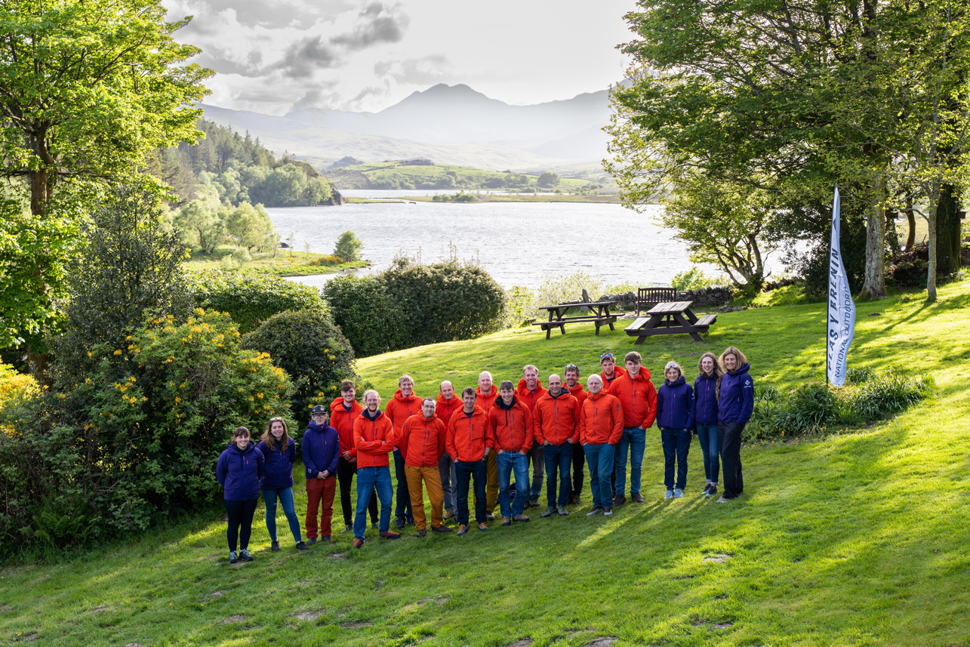
TRAINED BY THE HIGHEST LEVEL OF INSTRUCTORS

Slide 7
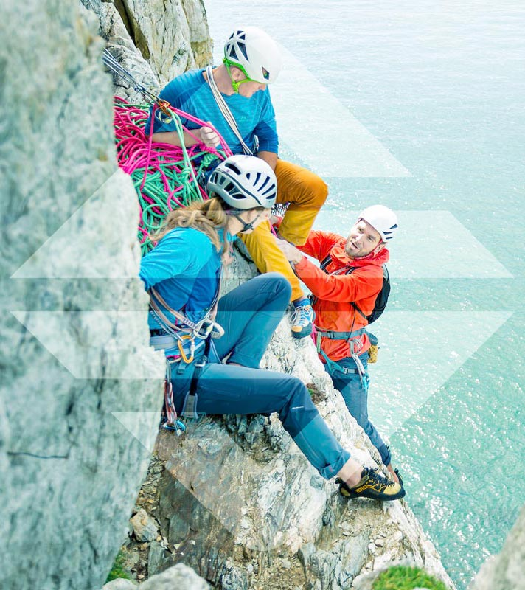
4 months of intensive training developing skills in a range of activities
5 Days a week instruction
80 Days instruction
Full board 5 days a week
Accommodation 7 days a week
Consolidation week
Credits

Slide 8
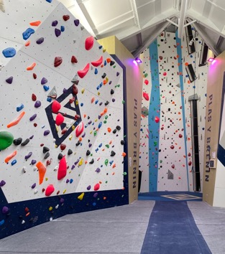
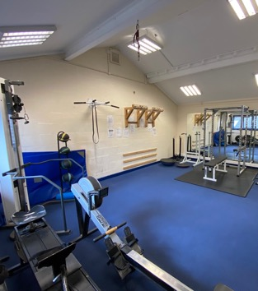
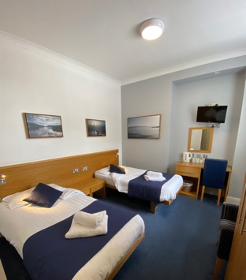
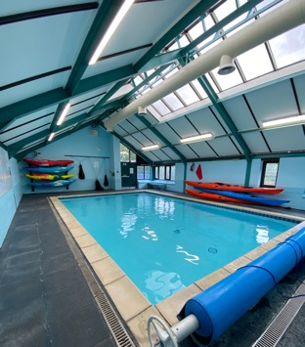
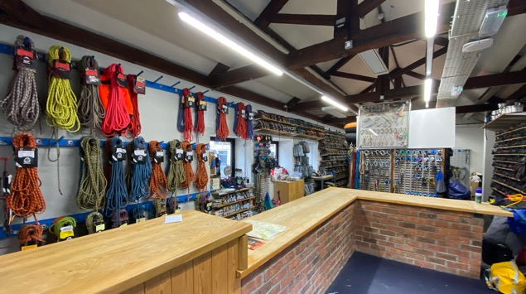
FACILITIES
Climbing wall
Pool
Stores kit
Gym
Evening lectures
Bar networking
Drying rooms

Slide 9

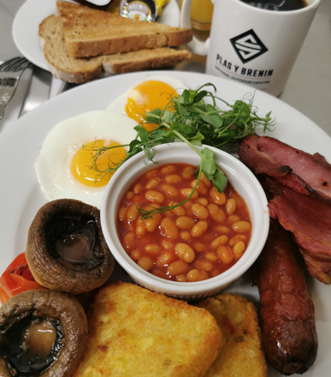

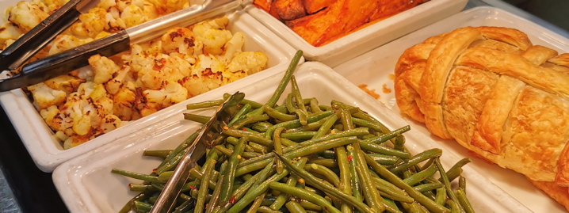
FOOD
Breakfast 7.30 – 8.30
Packed lunch
Dinner 7.00 -7.45

Slide 10
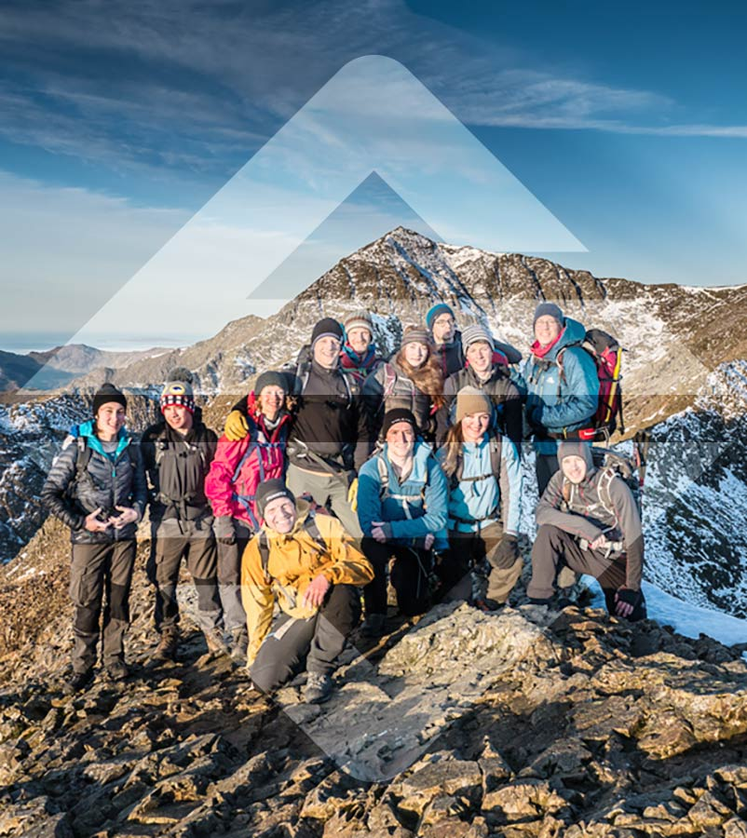
ALL AGES
PERSONALISED
LIVING TOGETHER
ADVENTURES TOGETHER

Slide 11

MOUNTAIN SKILLS

Slide 12
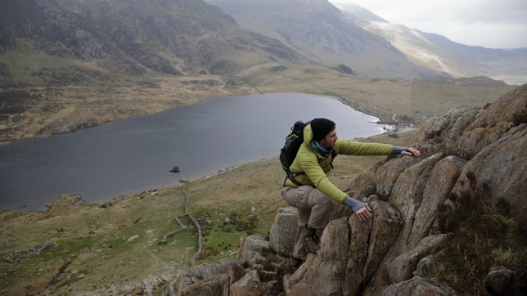
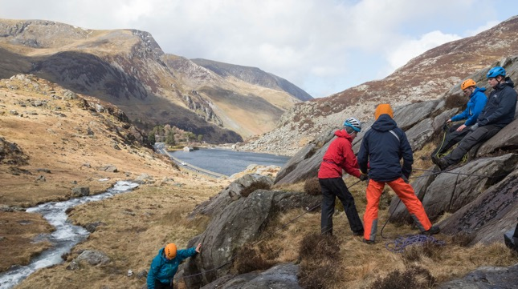
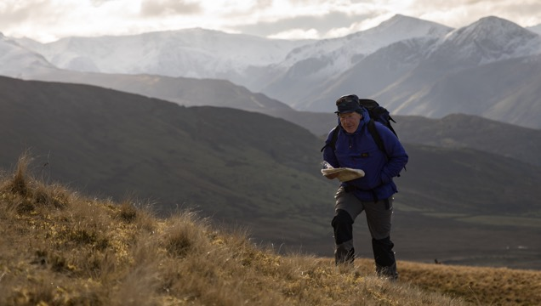
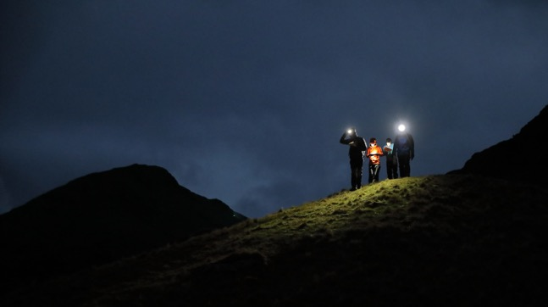

Slide 13
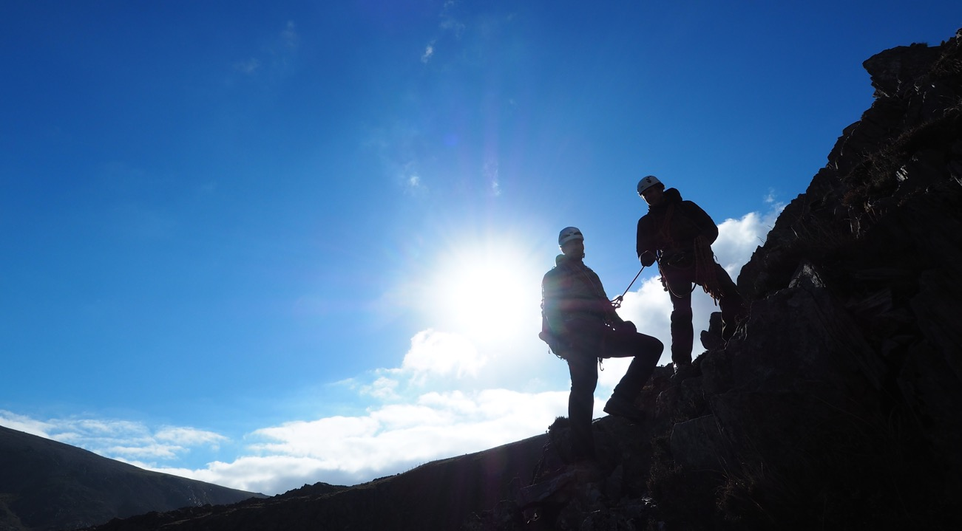
SUMMER
MOUNTAINEERING
SKILLS

Slide 14
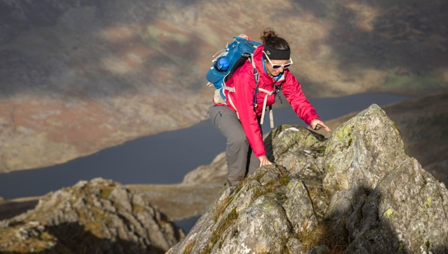
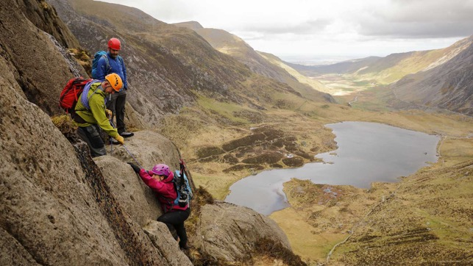
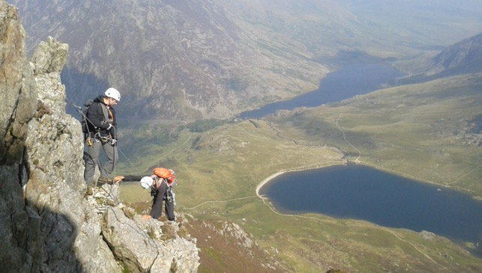
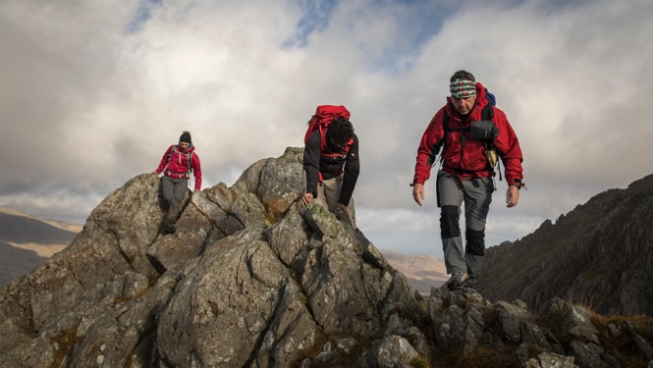

Slide 15
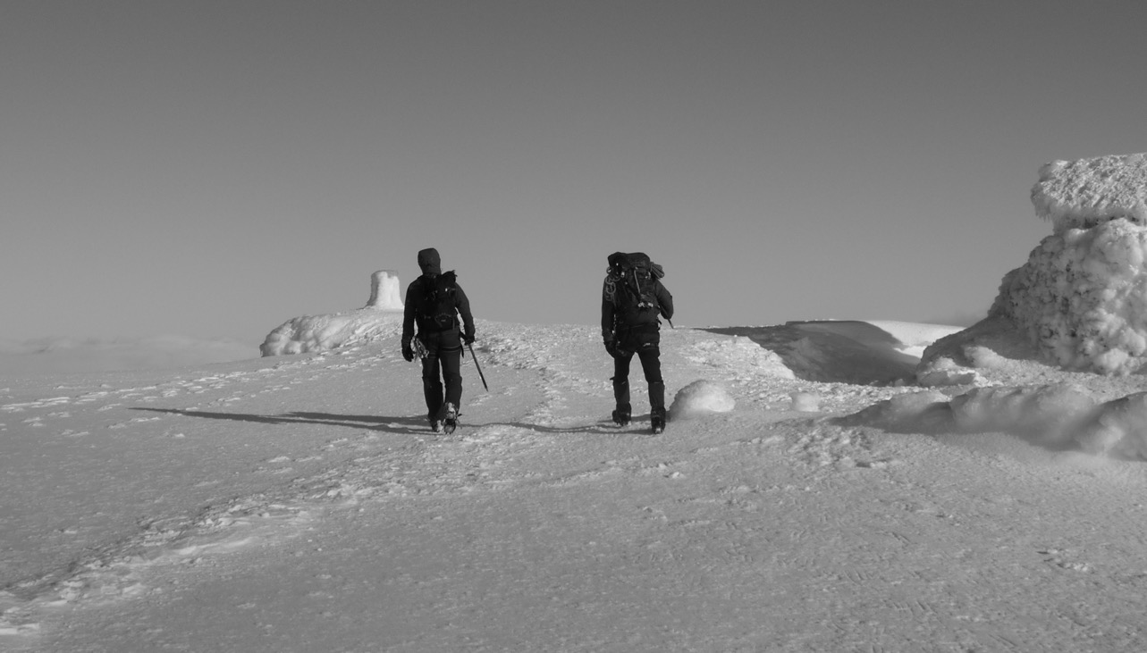
WINTER
MOUNTAINEERING
SKILLS

Slide 16
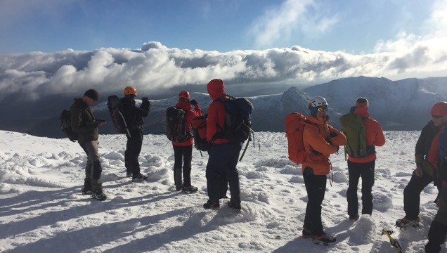
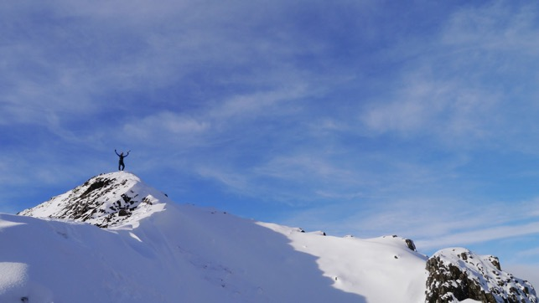
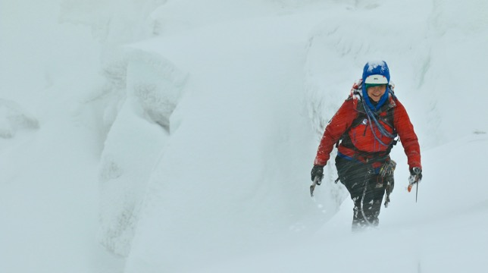


Slide 17
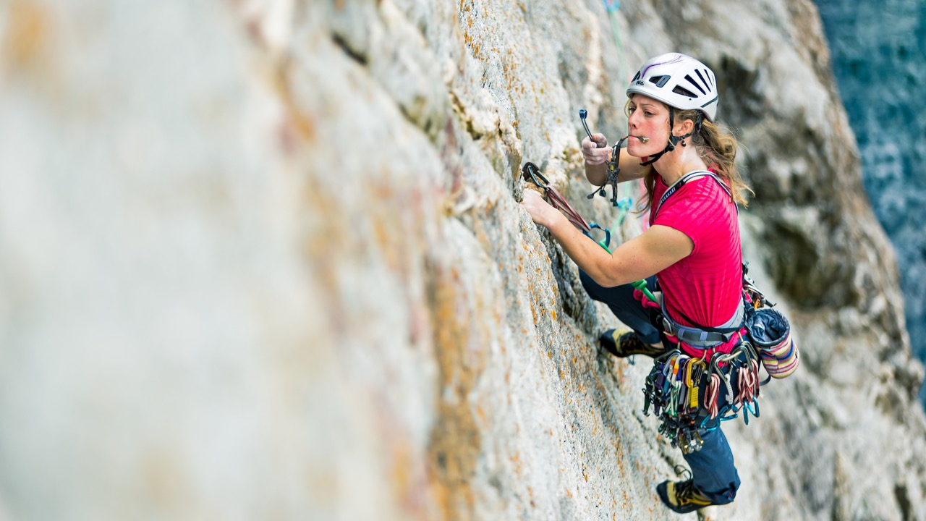
ROCK CLIMBING

Slide 18
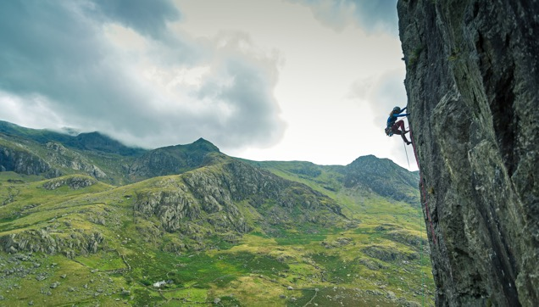
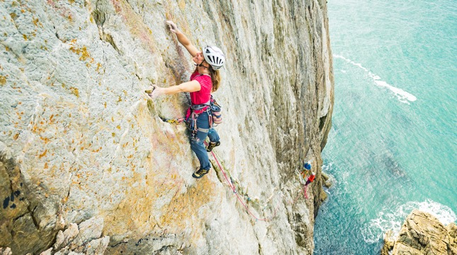
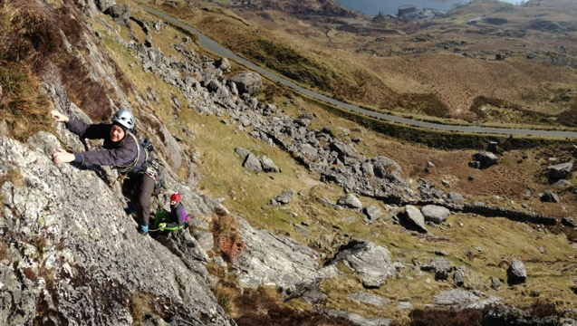
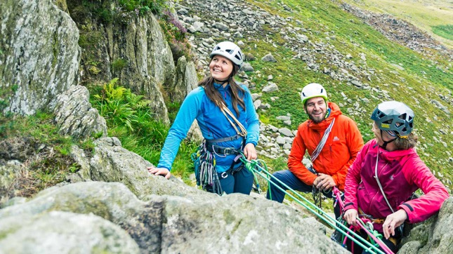

Slide 19
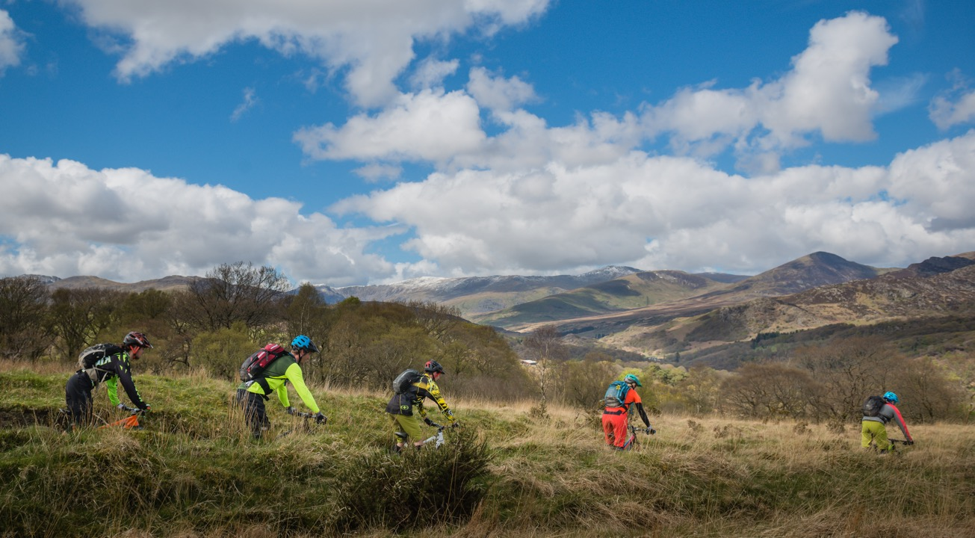
MOUNTAIN BIKING

Slide 20
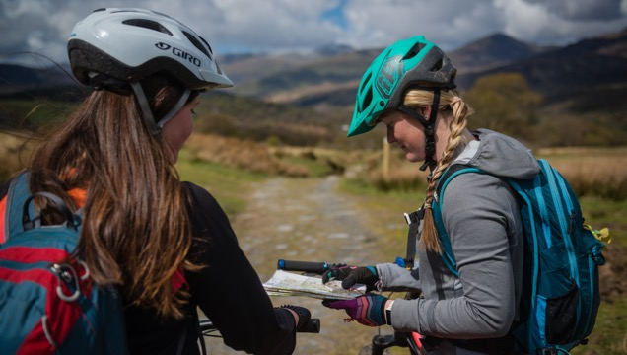
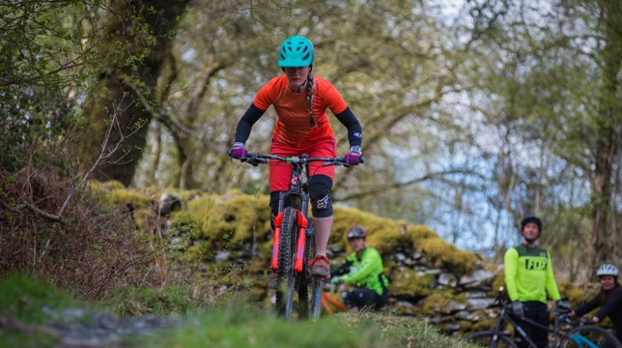
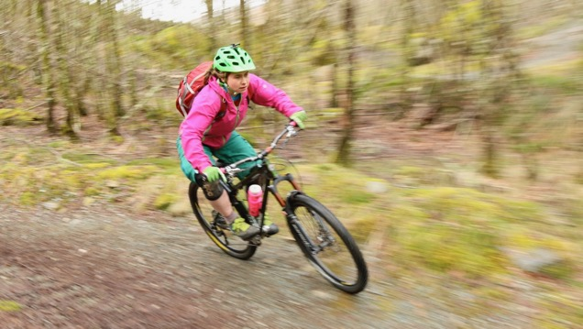
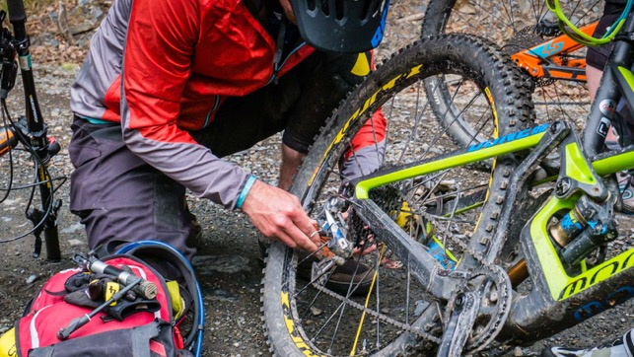

Slide 21
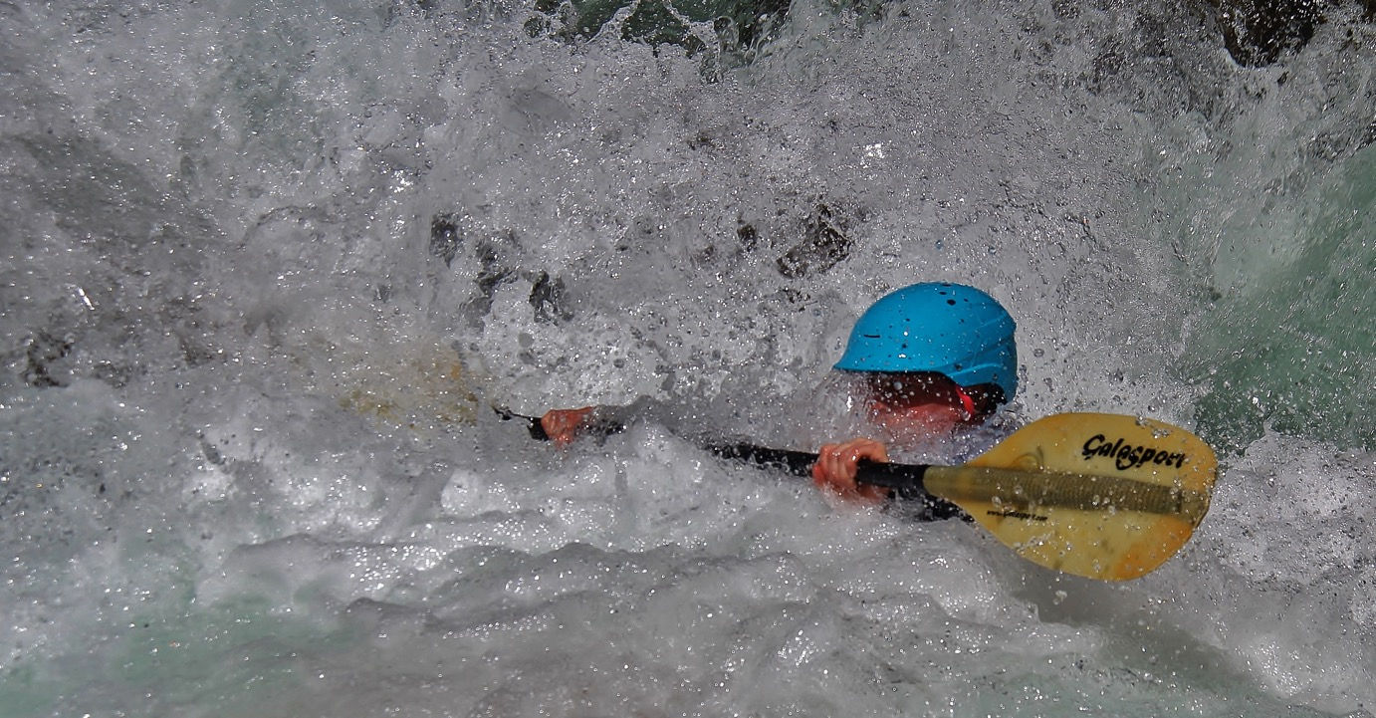
PADDLE SPORTS

Slide 22
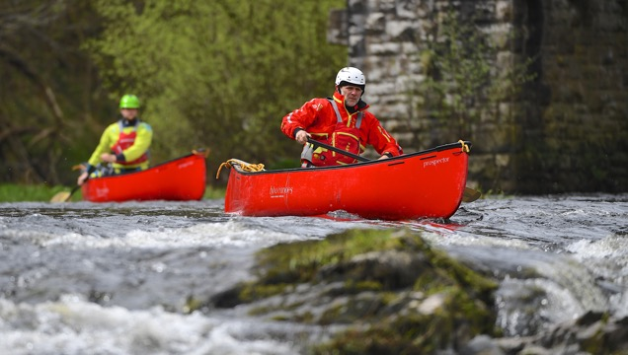
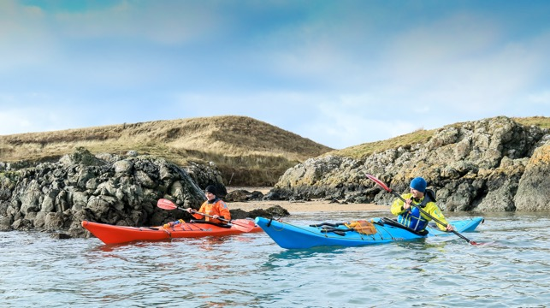
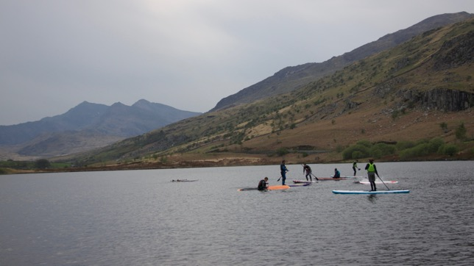
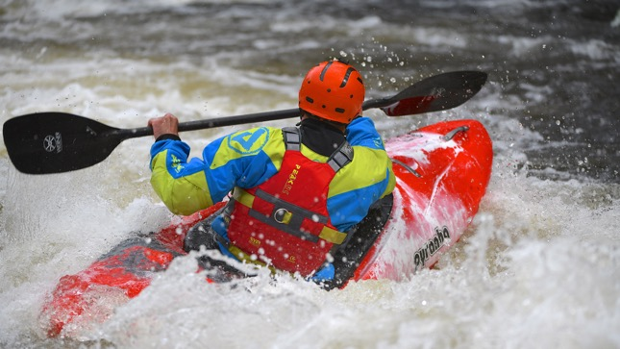

Slide 23
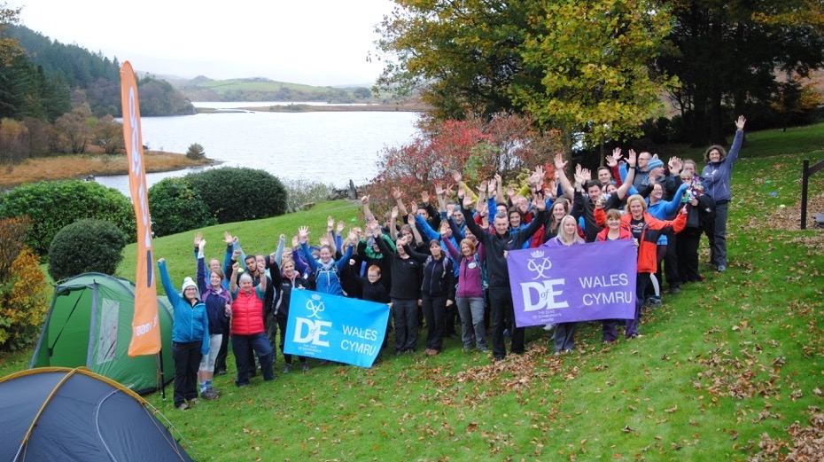
QUALIFICATIONS COURSES
FIRST AID
SAFE GUARDING AND PROTECTING YOUNG PEOPLE
D OF E ASSESSORS ACCREDITATION SCHEME
DISCOVER KAYAKING/CANOEING
FOUNDATION SAFETY AND RESCUE
SAFE WORKING AT HIGHTS

Slide 24
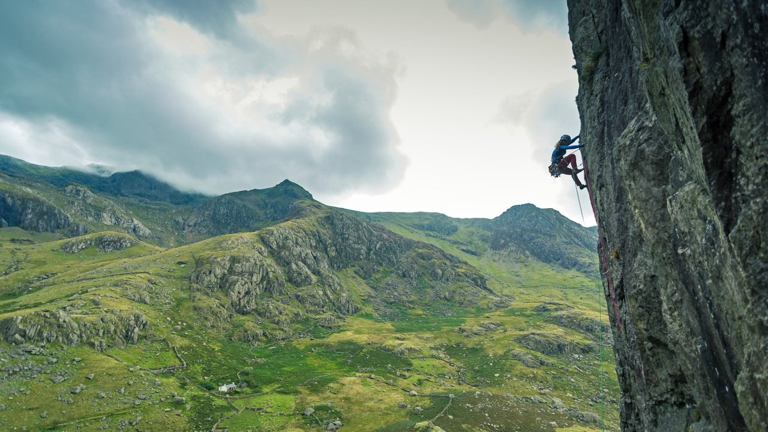
QUALIFICATIONS COURSES
MOUNTAIN LEADER TRAINING
FUNDAMENTALS 1 AND 2
FOUNDATION COACH AWARD (ROCK CLIMBING)
CLIMBING WALL INSTRUCTOR TRAINING
ROCK CLIMBING INSTRUCTOR TRAINING
LEVEL 2 MOUNTAIN BIKE LEADER TRAINING
PADDLE SPORT INSTRUCTOR

Slide 25
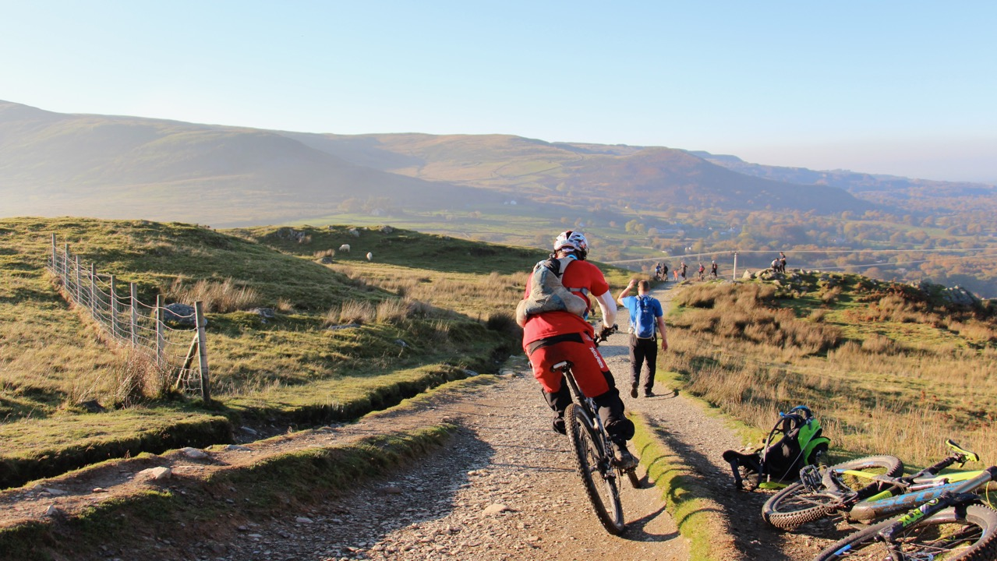
ADVANCED QUALIFICATIONS COURSES
ROCK CLIMBING INSTRUCTOR ASSESSMENT
MOUNTAIN LEADER ASSESSMENT
INTERNATIONAL MOUNTAIN LEADER TRAINING
WINTER MOUNTAIN LEADER TRAINING
MOUNTAINEERING INSTRUCTOR AWARD TRAINING
LEVEL 2 MOUNTAIN BIKING LEADER ASSESSMENT
ADVANCED FIRST AID

Slide 26
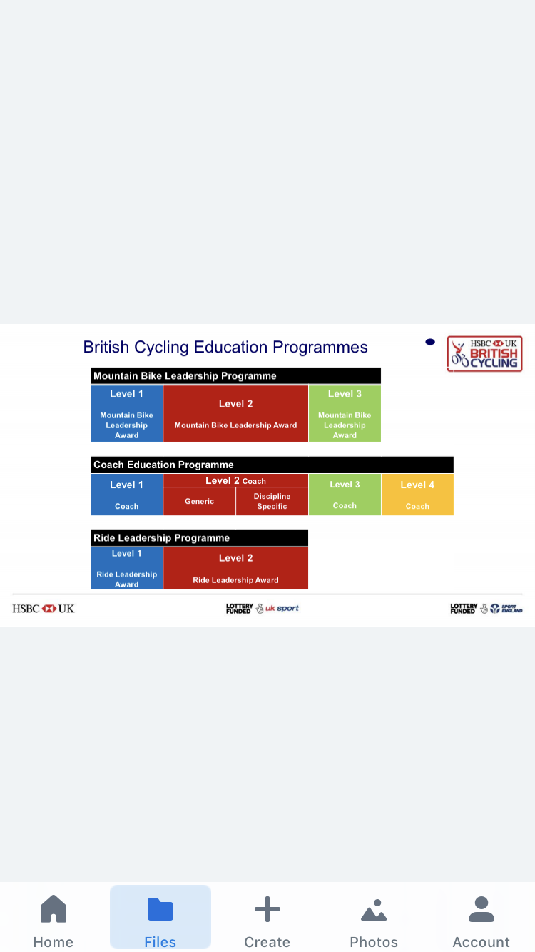

DIRECT ENTRY
CONSOLIDATION

Slide 27
QUALIFICATIONS PATHWAY*
CONTACT BRITISH CYCLING
TO REGISTER FOR PROGRAMME
BOOK ASSESSMENT
BOOK TRAINING COURSE
COMPLETE AND SUBMIT
WRITTEN ASSIGNMENT
COMPLETE AND SUBMIT LOGBOOK
CONSOLIDATION PERIOD
ATTEND ASSESSMENT
SUBMIT PROOF OF FIRST AID
TRAINING
RECEIVE CERTIFICATE AND
LEADERSHIP LICENSE
*Direct entry is also available.
ATTEND TRAINING

Slide 28
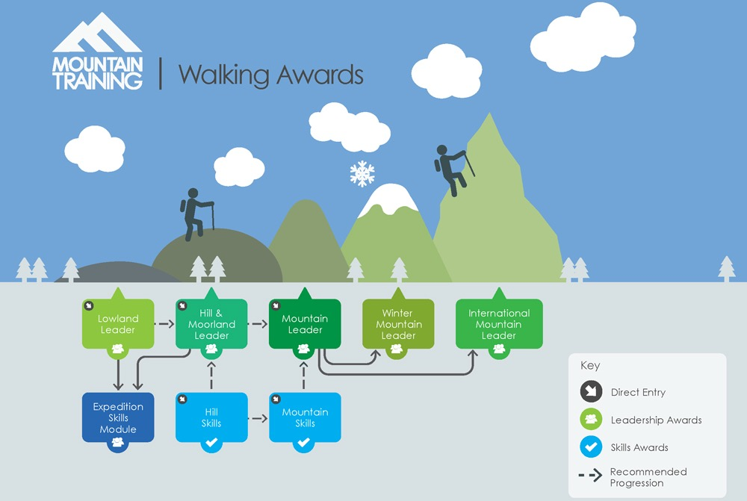

Slide 29
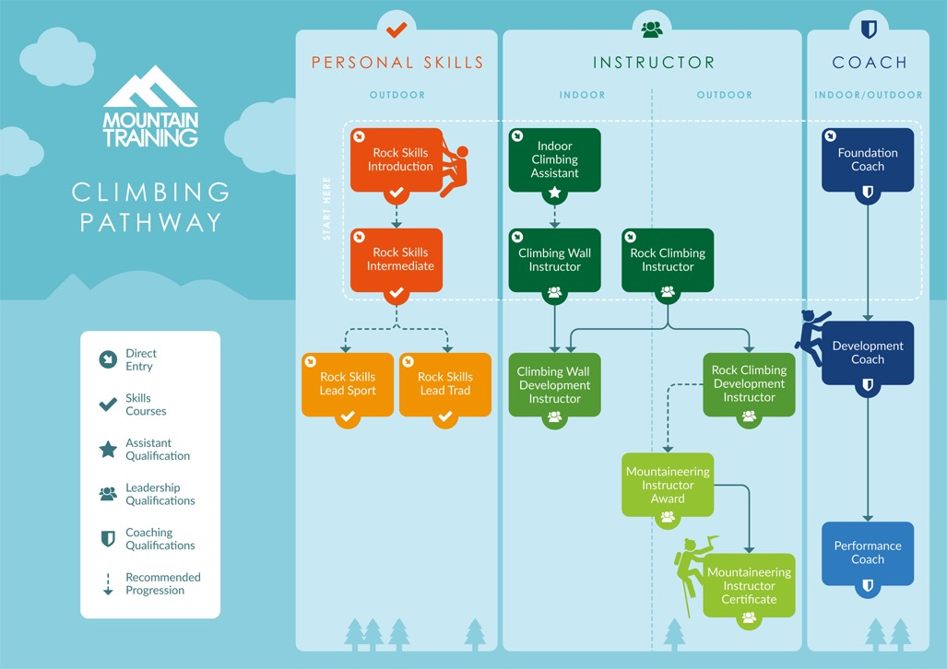

Slide 30

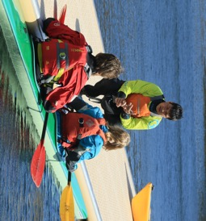
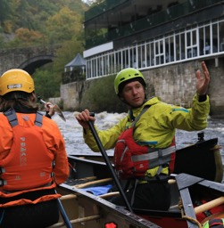
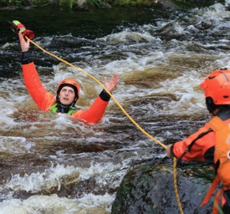
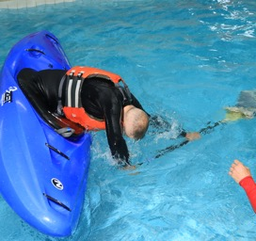
QUALIFICATIONS & AWARDS
COACHING
LEADERSHIP
SAFETY
PERSONAL DEVELOPMENT

Slide 31

QUALIFICATIONS
PADDLE SPORT INSTRUCTOR
COACH AWARD
PERFORMANCE COACH AWARD
COACHING
COACHING DIPLOMA

Slide 32
QUALIFICATIONS PATHWAY
CORE
COACH
TRAINING
[2 days]
DISCIPLINE
SPECIFIC
TRAINING
[2 days]
ASSESSMENT
[1 day]
DIRECT ENTRY
CONSOLIDATION
eLEARNING | SUPPLEMENTARY LEARNING | EXPERIENCE

Slide 33

ADVANCED QUALIFICATIONS COURSES PADDLE SPORTS
WHITE WATER KAYAKER/PROGESSIVE WHITE WATER
CANOEIST/PROGRESSIVE CANOEIST
PADDLE SPORT LEADERS AWARD
WHITE WATER SAFETY AND RESCUE
CORE COACH TRAINING
DISCIPLINE SPECIFIC TRAINING
COACH ASSESSMENT

Slide 34

CREDITS FOR FAST TRACK
IF YOU CHOOSE TO FINISH EARLY, WE CREDIT 10 DAYS AT NO ADDITIONAL COST (USE WITHIN 12 MONTHS)
THEY CAN BE USED ON NATIONAL GOVERNING BODY QUALIFICATION TRAINING OR ASSESSMENT COURSES.

Slide 35
‘Plas y Brenin – Fast Track Adventure Pro’ Video
https://youtu.be/Pezm5e_J0P4

Slide 36
‘Becca Cronk – Fast Track Pro Interview’ Video
https://www.facebook.com/plasybrenin/videos/becca-cronk-fast-track-adventure-pro-interview/677234145992542/

Slide 37
YOUR ADVENTURE AWAITS

